Slide 1
The Puzzle Box
Note: Please view these slides in presentation mode to view demo videos.

Slide 2
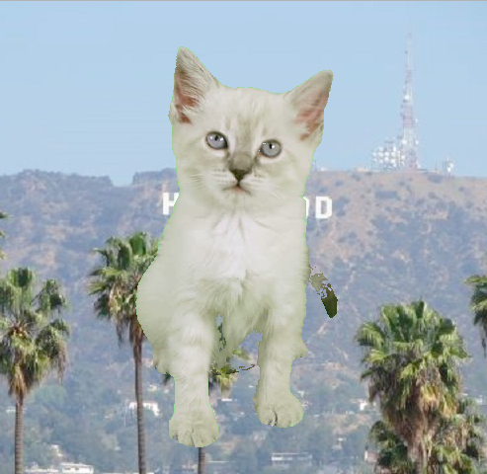
Hello!
We Are Team Betawares
Christopher Buckey
Patrick Gonzalez
Christopher Holmes
Michael Loeser
John Seals

Slide 3
1.
Objective
Make the plan

Slide 4
For our final project our team decided to create a box of puzzles. We each decided to create a puzzle of our choice and bring it all together to create this toy box puzzles. We have two image based puzzles , a sound bit puzzle and a text based puzzle.

Slide 5
2.
Approach
Execute the plan,

Slide 6
Splitting Up the Work:
Christopher Buckey
Trivia Game
Patrick Gonzalez
Jigsaw Puzzle
Christopher Homes
Memory Game
Michael Loeser
Sound Puzzle
John Seals
Game Host

Slide 7
3.
Results
Expect the plan to go off the rails,

Slide 8
Controller Function & Intro Text
Step 1:
Our puzzle collection would need a main function which would call the various games and keep track of whether the player had won or lost. I implemented the main function which runs inside a while loop and continues until either the user solves all the puzzles or chooses to quit. This implementation would resolve program termination errors we experienced in our previous project.
Step 2:
Next we would need a sharp, edgy introduction to our game. We decided that a plot based introduction would be highly desirable and I was chosen to write the intro text. The draft was posted early in the development process in order to collect feedback/suggestions on the plot and writing style with the final version being inserted into the main controller function.
John Seals

Slide 9
The Jigsaw Puzzle
Patrick Gonzalez
Step 3:
To swap the images I used a form of sorting technique by creating a variable to hold the image pieces and then used the player input as the key for where to reassigned those images to within the shuffled dictionary. After every input and swap I then pieced the shuffled dictionary images back together for the player and then compared the completed shuffled board image to the original image. If each pixel color didn't match that of the original image I asked the player for a new set of images to swap. Once the pieced together shuffleboard image matches the original the player wins the game.
Step 2:
In order to accept the command from the player to swap two images pieces I had to reassign the shuffled dictionary keys to be in order from 0-8 but still keep the image pieces/values in the shuffled order. Then I showed the player the shuffled image pieces and asked the player which two image pieces they would like to swap. So long as the player input a legal command or exit or help I then swapped the images.
Step 1:
I took a 720x540 image and split it into 9 pieces. I then stored those images into a dictionary, with keys 0-8. In order to mix up the puzzle pieces I had to create a randomized list with the values 0-8. Then I made a new dictionary and used the random list to create a new order of the puzzle pieces. Now that I have a new dictionary with the shuffled image pieces I put them all together into a new image.

Slide 10
Sound Puzzle
Michael Loeser
Step 3:
Entry validation is done to ensure formats of the user submissions are correct. Clips can only be from 1-6. Attempts to play the order must be in format “Play # # # # # #”.
An attempt to play is tested by looping through the user entries and matching the clip dictionary using a 0-5 loop index. If the clip retrieved for each iteration of the loop has the key matching the loop index, it continues on to the next test. If it makes it successfully through to the end of the loop, the user wins!
The user is given 4 chances to put together the clips, then they lose!
Step 2:
The interface allows the user to play one of the clips by providing it’s index (Ex: “2”) or attempt to “play” their order to see if it matches the original (Ex: “Play 2 3 4 1 6 5”).
The user entry is matched to the value stored in the list using the “index()” function of the list.
The index for the given value points to the key in the dictionary storing the clips.
The clip is stored in the dictionary and can be played directly.
Step 1:
The program can take any sound byte. It chops the soundbyte into 6 equal length clips and stores them in a dictionary. The number of chopped clips can be easily adjusted, but the puzzle becomes too complex with smaller sound clips.
Another list is created with values 1-6 and then shuffled. The indexes of these values are what the user is testing against.

Slide 11
Trivia Game
Chris Buckey
Step 3:
The user would be asked a series of fairly-hard questions. IF the user answered three of these questions correctly, they would be able to move on. If the user answered 7 of the questions incorrectly, they would lose the game. The game would be much much easier if the user knew the cheat code, in which all he would have to do is enter the word cheat and win the game.
Step 2:
The second function would randomly pick a question from the first function (the one with the questions and answers) and display them. If the user answered correctly, then the program would confirm it was correct. The same happens for incorrect answers. The win condition is 3 correct answers. The losing condition is 7 incorrect answers.
Step 1:
I created two arrays: one to hold the questions for the trivia game, and the other for holding the answers. I then created the conditions for correct or incorrect answers. If the user entered the correct answer, or the word “cheat” (as a cheat code), the function would register the answer as correct. Anything else would be returned as incorrect.

Slide 12
The Memory Game
Christopher Holmes
Step 3:
To actually play the game, I would have the user input the letter on the back of the card that they wanted to guess. From there it would correctly pull the right image, and would use a compare function to see if the images are the same. If the images were the same, it would print that a match was found and leave those images on the board. If it was not a match, the images would display for 5 seconds and then revert back to the letters to be picked again. Once all matches were found it says you won and returns true.
Step 2:
Once I had the logic worked out and the game running, I modified it to be used in JES with images. To use the images, I had to set the working directory so that all the images could be read in automatically. I would then need to construct the boards with those images and be able to display these boards appropriately since they were no longer just lists of text, but rather images.
Step 1:
I first wrote this game as a text based game so that I could work out all the bugs in the logic without having to worry about the images or any of the extra complications that might be added by JES. The game generates two 2D lists to be used as the game boards and to verify if answers are correct or incorrect. I used multiple helper functions to make the code easier to read and process.

Slide 13
4.
Demo
Throw away the plan!😂

Slide 14
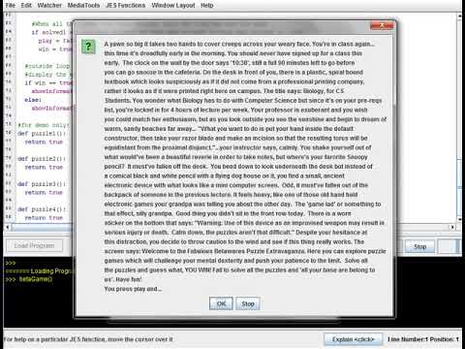
Controller Function
Here is a video showing how our main controller function works. We display our intro message, then prompt for user input. When the user decides which game to play, we will call that game’s function. If the player successfully solves all the puzzles, they win!
John Seals

Slide 15
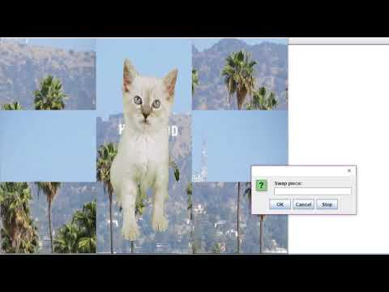
Jigsaw Puzzle Demo
Patrick Gonzalez
In this video you can see that I begin by showing the shuffled image board to the player and then give them direction as well as how each piece is numbered. Then I asked the player for two pieces to swap. After performing the swap I show the shuffled images again and ask the player for another set of images to swap. Once all the piece are in the right place the player wins the game unless the type exit then they can leave the game.

Slide 16
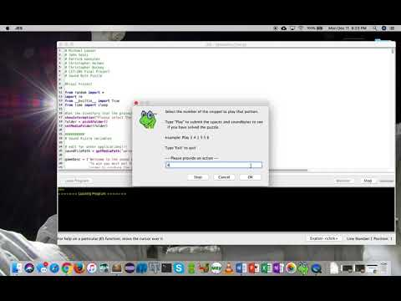
Sound Puzzle Demo
Michael Loeser
In this video I am doing a demo of the Sound Puzzle game. The intent of the game is to put back a list of 6 randomly ordered clips into a great scene from one of the funniest movies ever made, Young Frankenstein.
The user has the option of playing the clips or attempting to “play” their clip order to see if it is correct.
If they can get the order right within 4 tries, they win! If not, they lose and exit the game.
Place your screenshot here

Slide 17
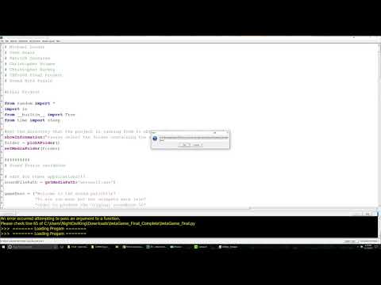
Trivia Game Demo
Chris Buckey
In this video I am doing a demo of the Trivia Game. The game asks the user a bunch of questions, and tells them if they answered correctly or not. Of course, the user could also use the cheat code to display a correct answer. If the user answers 3 questions correctly, they win the game. If the user answers 7 questions incorrectly, they lose.
Place your screenshot here

Slide 18
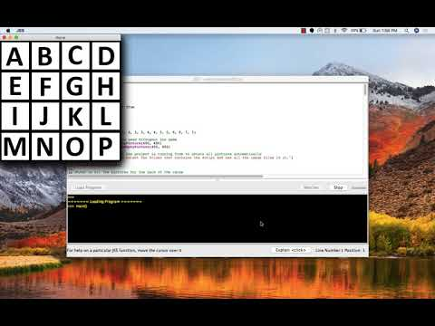
Memory Game Demo
Christopher Holmes
In this video I am doing a demo of the Memory game. The object of the game is to successfully match each of the different pictures that are on the game board. The user has as many tries as they would like to solve the game. In the demo, I select the folder that contains the images, attempt to find a match, and then quit the game after a match. If they cannot solve it, they can hit q to exit the game and they do not win the game.
Place your screenshot here

Slide 19
5.
What we learned

Slide 20

Learning & Professional Development
Good communication is vital to the development process
Teamwork is vital, delegation of responsibility and breaking large problems into individual chunks for group memebers to solve is essential to manage time
Software Development Process: Clearly define all expecations/pre & post conditions before you start coding!
John Seals

Slide 21
You live and you learn.
Patrick Gonzalez
Lesson 1:
I learned that teamwork matters. Whenever I struggled through certain portions of my work my teammates were there to help me out.
Lesson 2:
I also came to appreciate using pseudo code to logically layout a plan. I normally just jump right into coding but I found that harder to do this time. So I took a step back and pseudo coded my whole project before moving forward and it helped me come up with different methods to use for my project over all.
Lesson 3:
The last lesson I learned through this experience is to think out of the box about solving problems. For my project I used a combination of different sorting techniques that I would not normally use them as.

Slide 22
You live and you learn.
Christopher Holmes
Lesson 1:
I learned that dictionaries are very powerful. They made solving certain aspects of the game much easier than I expected.
Lesson 2:
Breaking down problems into smaller tasks makes it a lot easier to solve things. When I first started the project I was thinking the final product and it was overwhelming. By breaking it down into smaller chunks it made it easier to have those mental milestones of success and eventually a working game.
Lesson 3:
Lastly, budgeting time. When I originally laid out a timetable to be able to finish this, I underestimated by a long shot. Once I started working I was able to better gauge how much time I needed.

Slide 23
Media can be fun!
Michael Loeser
Lesson 1:
Media files are nothing more than ordered files based on samples and numeric digits. They can be manipulated easily and with simple to understand tools. Very cool!
I really had a good time with these projects.
Lesson 2:
Even though our projects are relatively straightforward and easy, they can be time consuming. Budget time appropriately!
Also, I learned to make sure to keep some time available to help classmates. Everyone on the team should do well.
Lesson 3:
I keep learning that the projects and work assignments can be tricky. Read through them multiple times to get all of the detailed info and ensure that all requirements are met.

Slide 24
Like photoshop...but with a python
Chris Buckey
Lesson 1:
Images are nothing more than a series of pixels, and can be manipulated individually or through a for loop. Likewise, sounds are nothing but a series of sound bytes that can likewise be manipulated.
Lesson 2:
Python is an easy language to pick up and learn. I never thought I’d be a week into learning a new language and already manipulating images and such. That said, the programming can be time consuming, so it is not a good idea to start projects on the day that they are due.
Lesson 3:
Sounds, in particular, are tricky to manipulate. HOwever, once you figure that out, you can do a lot of interesting things with them in Python. That applies to nearly everything in Python.

Slide 25
Furthermore,
Group Status Doc
https://docs.google.com/document/d/16nwniOCphB4xkGAEI2gSROdLsSsTKVPEjwcy-p5fK_g/edit

Slide 26
Thanks For Your Time!

Slide 27
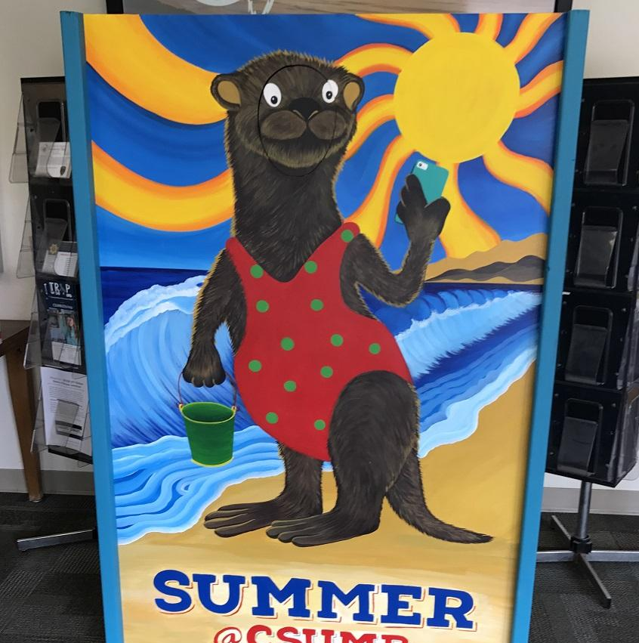
Credits
Special thanks to all the people who made and released these awesome resources for free:
Presentation template by SlidesCarnival
Photographs by Patrick Gonzalez

